Slide 1
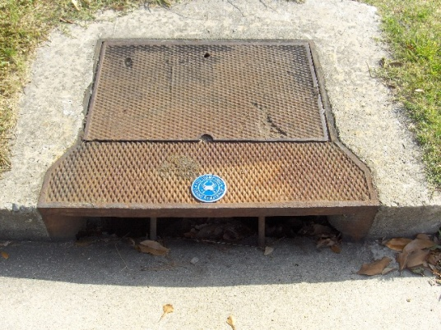
Storm Drain Medallion
Mini-Grant Program

Slide 2
Storm Drains
Storm drains are the entrance to the drain system that transports excess water from streets, parking lots and sidewalks to nearby waterways. Like the overflow drain in your sink, storm drains give water another place to go in order to prevent flooding.

Slide 3
Rain
Rain
Rain
Buildings
Parking Lot
Storm Drain
Sidewalk
Street
Storm Drain System
Waterway

Slide 4
Stormwater Runoff
Stormwater runoff occurs when rain or melted snow flows over parking lots, sidewalks, streets, or any other surface that cannot absorb water. As stormwater runoff moves, it picks up dirt, trash, oil, grease, fertilizers, and other pollutants and carries them into the storm drain system, which empties directly into local waterways.

Slide 5
Pollutants In Our Waterways
There are 3 types of pollutants that are the major causes of pollution in our local waterways: Nitrogen, Phosphorus and Sediment.

Slide 6
Nitrogen
Nitrogen is a chemical element (N). Nitrogen is found in fertilizers, grass and leaves that have started to turn brown, and wastewater.
Algae blooms feed off nitrogen in the water. When there is too much nitrogen, the algae blooms grow very quickly and block sunlight and reduce dissolved oxygen which is needed by fish, blue crabs and other organisms.

Slide 7
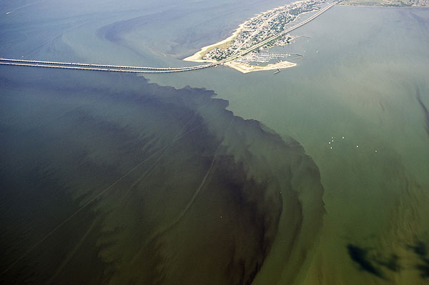
This picture shows an algae bloom in the Chesapeake Bay by the start of the Hampton Roads Bridge Tunnel in Norfolk. Photo was taken in August, 2009. (Photo from The Virginia Pilot).

Slide 8
Phosphorus
Phosphorus is a chemical element (P). Phosphorus is found in fertilizers, herbicides and wastewater.
Like nitrogen, phosphorus also feeds algae blooms which make the water unlivable for fish, blue crabs and other organisms.

Slide 9
Sediment
Excess sediment gets into our waterways from eroding land and stream banks.
Too much sediment suspended in the water clouds the water, harming fish, oysters, and aquatic grasses.

Slide 10
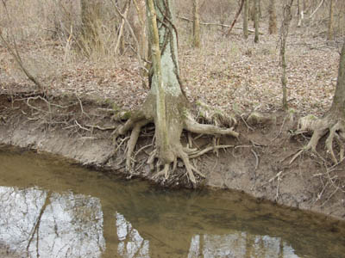
This picture shows the effects of stream bank erosion. The soil is not held down by vegetation, so it can easily wash into the stream when it rains. (Photo from Great Swamp Watershed Association).

Slide 11
How You Can Help
Only let rain go down the storm rain
Pick up pet waste
Sweep up anything that is lying on pavement
Plant native flowers, trees and shrubs
Leave lawn clippings on lawn after mowing to let the nutrients return to the grass instead of using fertilizer.

Slide 12
Spread The Word!
Thank you for helping us inform people that storm drains lead directly to waterways!

